Slide 1
Argumentation framework with constraints
Student: Ștefan Drăgoi
Coordinator: Lect. Dr. Andrei Cristian Frăsinaru
Notes:
Hello, I am Stefan Dragoi and coordinated by lecturer Andrei Cristian Frasinaru, we have developed an application which has integrated an algorithm that determines the properties of an Abstract Argumentation Framework, as the concept was defined by Dung in 1995

Slide 2
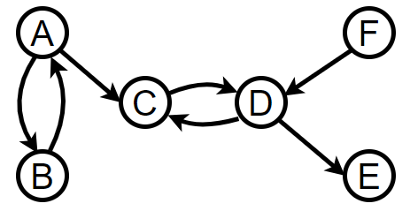
Abstract Argumentation Framework
An argumentation framework is a pair:
AF = <A, R>
A – a set of arguments
R – attacks between arguments
A = {A, B, C, D, E, F}
R = {(A, B), (B, A), (A, C), (D, C), …}
Notes:
This definition has been retrieved from Dung’s article, where he laid the basis of this theory which has been extended in the years that followed. An argumentation framework is a pair <A, R> where A is the set of arguments and R a binary relation, meaning the attacks between arguments. In general, an argumentation framework is represented as a directed graph as we have here. In this example the arguments are the letters from A to F and the attacks (A, B), (B, A), (D, E) and so on.

Slide 3
Context and objective
Argumentation framework has become a main study case within conferences related to Artificial Intelligence;
Argumentation framework has many applications in domains as: healthcare and debates;
The main objective was to propose a performant algorithm based on constraint programming which determines the properties of an Argumentation Framework;
Notes:
In the last years, Argumentation framework has increasingly become an important subject in conferences related to Artificial intelligence. This theory has a couple of applications in domains like healthcare and debates. For example, in healthcare, there is an application which uses Abstract Argumentation Framework to represent and synthesize knowledge from clinical trials and generates combinations of treatments that causes the fewest negative effects. There, the treatments are seen as arguments and relationships between them as attacks. Using an algorithm, the most efficient treatment was represented by the medicines which composed a grounded or preferred extension, which are properties of Argumentation Framework. Our main objective was to develop a performant algorithm which determines the properties of an Argumentation Framework and integrate it in a web application. We will see soon the performance results and the web application.

Slide 4
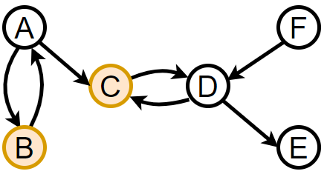
Abstract Argumentation Framework
Conflict-free extensions: {B, C},
Notes:
The first property is “conflict-free”. A set of arguments is said to be conflict-free if there is no attack between them. In this example {B, C} is conflict-free because these arguments do not attack each other. The same for set {A, D}.

Slide 5
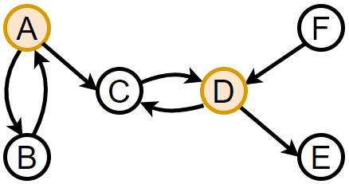
Abstract Argumentation Framework
Conflict-free extensions: {B, C}, {A, D};

Slide 6
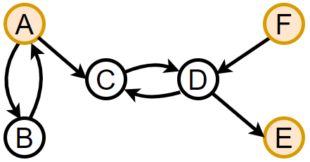
Abstract Argumentation Framework
Conflict-free extensions: {B, C}, {A, D};
Stable extensions: {A, E, F};
Notes:
A stable extension is a set of arguments which is conflict-free and has the characteristic that attacks all other arguments that do not belong to that set. In this example, {A, E, F} is a stable extension because there is no attack between them, so is conflict-free and attack all arguments that do not belong to extension, in our case B, C and D.

Slide 7
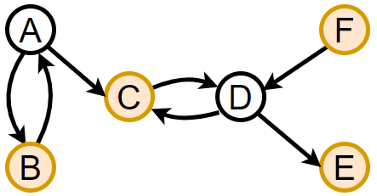
Abstract Argumentation Framework
Conflict-free extensions: {B, C}, {A, D};
Stable extensions: {A, E, F};
Admissible extensions: {B, C, E, F},
Notes:
An extension is admissible if all arguments are defended by the arguments of the extension. Here, {B, C, E} is admissible because B is defending itself, so it is part of the extension, C is defended by B with this attack and by itself with this attack and E is defended by C with this attack.

Slide 8
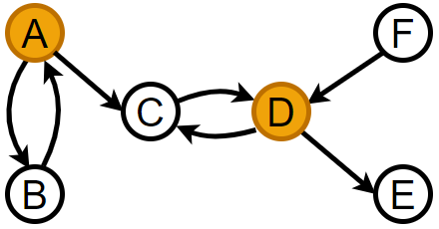
Abstract Argumentation Framework
Conflict-free extensions: {B, C}, {A, D};
Stable extensions: {A, E, F};
Admissible extensions: {B, C, E, F}, {A, D};
Notes:
On the other hand, {A, D} is not admissible because D is not defended by none of A or D from F.

Slide 9
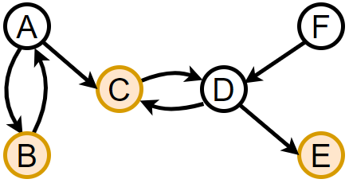
Abstract Argumentation Framework
Conflict-free extensions: {B, C}, {A, D};
Stable extensions: {A, E, F};
Admissible extensions: {B, C, E, F}, {A, D};
Complete extensions: {B, C, E},
Notes:
A complete extension is a set of arguments which defend themselves and only themselves, no one from the outside of the extension. In this example we have 2 complete extensions: {B, C, E} because they defend only arguments {B, C, E} and not others from the outside of the set. Another complete extension is {B, C, E, F}, here it’s added F which is not defended by no one so we can include it.

Slide 10
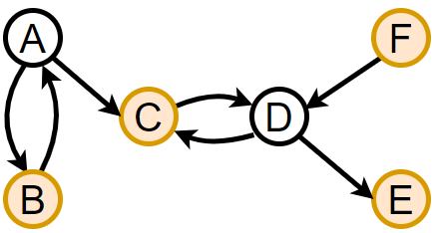
Abstract Argumentation Framework
Conflict-free extensions: {B, C}, {A, D};
Stable extensions: {A, E, F};
Admissible extensions: {B, C, E, F}, {A, D};
Complete extensions: {B, C, E}, {B, C, E, F};

Slide 11
Abstract Argumentation Framework
Conflict-free extensions: {B, C}, {A, D};
Stable extensions: {A, E, F};
Admissible extensions: {B, C, E, F}, {A, D};
Complete extensions: {B, C, E}, {B, C, E, F};
Preferred extension: {B, C, E, F};
Notes:
An extension is said to be preferred if it is the maximal admissible set of the system. In this case {B, C, E, F} is the maximal admissible set of the example.

Slide 12
Abstract Argumentation Framework
Conflict-free extensions: {B, C}, {A, D};
Stable extensions: {A, E, F};
Admissible extensions: {B, C, E, F}, {A, D};
Complete extensions: {B, C, E}, {B, C, E, F};
Preferred extension: {B, C, E, F};
Grounded extension: {B, C, E};
Notes:
And the last property is grounded which is minimal complete extension or with other words, the complete extension which is included in ALL complete extensions.

Slide 13
Algorithm
Implemented in Java using Choco-solver constraint library;
Approached the problem as a Constraint Satisfaction Problem (CSP);
Expressed Argumentation framework’s properties as Propositional Logic;
Transposed the resulted propositions in Choco-solver constraints;
Notes:
As I have mentioned at the beginning of the presentation, we have implemented an algorithm in Java which determines the properties of an argumentation framework. Our solution was to approach the problem as a Constraint Satisfaction Problem. To solve the constraints, we have used a Java constraint library called Choco-solver. The definitions of the properties have been transformed into propositional logic and then transposed them into Choco-solver constraints.

Slide 14
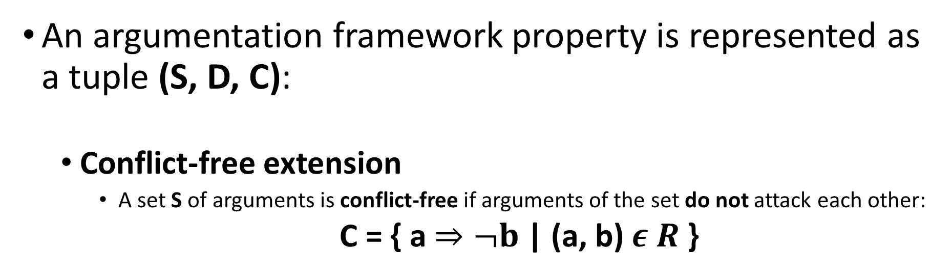
Algorithm
An argumentation framework property is represented as a tuple (S, D, C):
Conflict-free extension
A set S of arguments is conflict-free if arguments of the set do not attack each other:
C = { a$⇒¬b$ | (a, b) $ε R$ }
S = A (arguments) | $D_{i}=\{0, 1\}$ | C = constraint
Notes:
The process of property transformation has been executed in the following manner: we have defined an Argumentation Framework property as a tuple (S, D, C), where S are the arguments, D is the domain, 0/1 which means argument is included in extension or not and C the constraint. We have chosen two properties as example. For the first one is conflict-free, we have attached here the definition as a reminder, so a set of arguments is conflict-free if there is no attack between them. The constraint is defined as follows: if there exists an attack between a and b, then this implies that if a is included in extension, then b must not and vice versa.

Slide 15

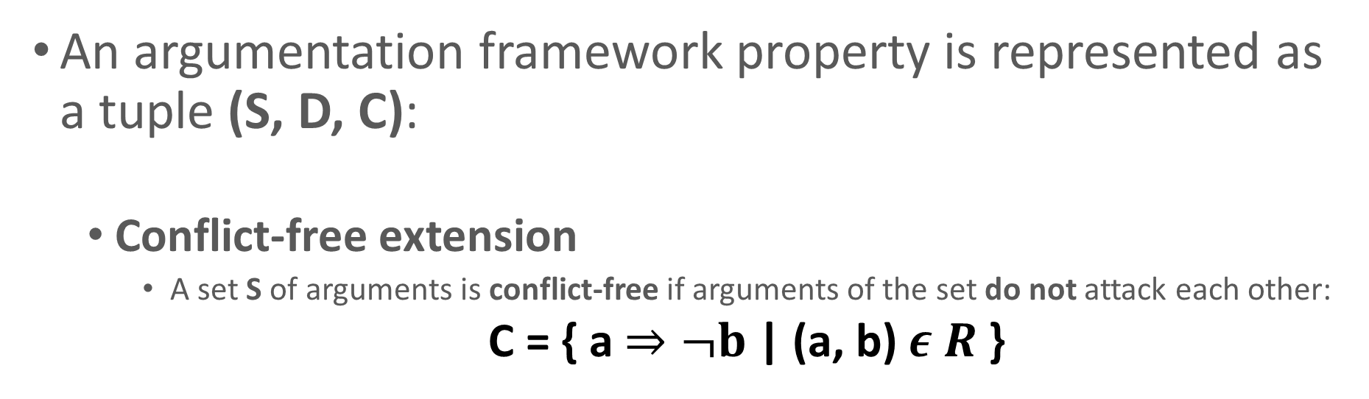

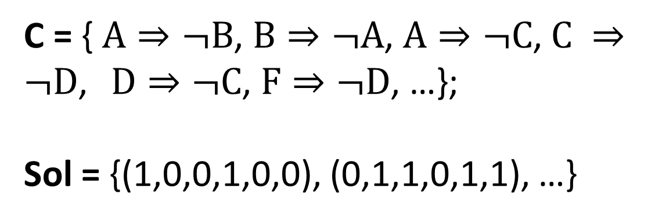


Algorithm
An argumentation framework property is represented as a tuple (S, D, C):
Conflict-free extension
A set S of arguments is conflict-free if arguments of the set do not attack each other:
C = { a$⇒¬b$ | (a, b) $ε R$ }
S = A (arguments) | $D_{i}=\{0, 1\}$ | C = constraint
C = { $A⇒¬B$, $B⇒¬A$, $A⇒¬C$, $C ⇒¬D$, $D⇒¬C$, $F⇒¬D$, …};
Sol = {(1,0,0,1,0,0), (0,1,1,0,1,1), …}
A
B
C
D
E
F
A
B
C
D
E
F
Notes:
The process of property transformation has been executed in the following manner: we have defined an Argumentation Framework property as a tuple (S, D, C), where S are the arguments, D is the domain, 0/1 which means argument is included in extension or not and C the constraint. We have chosen two properties as example. For the first one is conflict-free, we have attached here the definition as a reminder, so a set of arguments is conflict-free if there is no attack between them. The constraint is defined as follows: if there exists an attack between a and b, then this implies that if a is included in extension, then b must not and vice versa.

Slide 16

Benchmarking
 | Our device | Their device
Processor | Intel i7-11850H, 2.50 GHz | Intel i7-970, 3.20 GHz
RAM | 16 GB | 16 GB
ASPARTIX – ICCMA 2015, 2019, 2021
ConArg2 – ICCMA 2015, 2017, 2021
Source: https://conarg.dmi.unipg.it
 |  |  |  | Kleinberg |  |  |  |  |  | Erdős–Rényi
 |  |  |  | 25 |  | 36 |  | 49 |  | 100 |  | 200 |  | 300
 |  | Our algorithm |  | 0.10 |  | 0.12 |  | 0.15 |  | 0.25 |  | 6.63 |  | 129.26
admissible |  | ASPARTIX |  | 0.08 |  | 2.57 |  | 157.00 |  | 0.98 |  | 81.30 |  | 96.40
 |  | ConArg2 |  | 0.01 |  | 0.13 |  | 8.43 |  | 0.05 |  | 13.30 |  | 11.00
 |  | Our algorithm |  | 0.10 |  | 0.13 |  | 0.17 |  | 0.29 |  | 7.28 |  | 116.18
complete |  | ASPARTIX |  | 0.03 |  | 0.67 |  | 20.90 |  | 0.02 |  | 1.69 |  | 83.50
 |  | ConArg2 |  | 0.01 |  | 0.06 |  | 1.59 |  | 0.01 |  | 0.73 |  | 68.70
 |  | Our algorithm |  | 0.01 |  | 0.03 |  | 0.03 |  | 0.01 |  | 0.20 |  | 65.18
stable |  | ASPARTIX |  | 0.01 |  | 0.05 |  | 0.54 |  | 0.01 |  | 0.22 |  | 11.32
 |  | ConArg2 |  | 0.01 |  | 0.01 |  | 0.04 |  | 0.01 |  | 0.09 |  | 5.88
 |  | Our algorithm |  | 0.09 |  | 0.12 |  | 0.17 |  | 0.27 |  | 7.73 |  | 111.98
preferred |  | ASPARTIX |  | 0.35 |  | 4.67 |  | 85.20 |  | 0.33 |  | 0.99 |  | 3.04
 |  | ConArg2 |  | 0.04 |  | 1.96 |  | 230.00 |  | 0.04 |  | 4.53 |  | 117.00
 |  | Our algorithm |  | 0.12 |  | 0.17 |  | 0.16 |  | 0.29 |  | 6.94 |  | 121.26
grounded |  | ASPARTIX |  | 0.44 |  | 9.48 |  | 39.10 |  | 0.16 |  | 1.16 |  | 3.92
 |  | ConArg2 |  | 0.19 |  | 0.07 |  | 0.11 |  | 0.01 |  | 0.90 |  | 75.90
Notes:
I have said at the beginning of the presentation when I talked about the objectives of this dissertation paper that we proposed to implement a performant algorithm which solves the properties of an Argumentation Framework. I compared our algorithm with other 2 algorithms: ASPARTIX and ConArg2. Both of these applications participated at the International Competition on Computational Models of Argumentation, the biggest competition related to argumentation in 2015, 2017, 2019 and 2021. The tests has been executed on 2 types of graphs: Kleinberg and Erdos-Renyi. The results are exposed in this table and the conclusions in on the next slide.

Slide 17
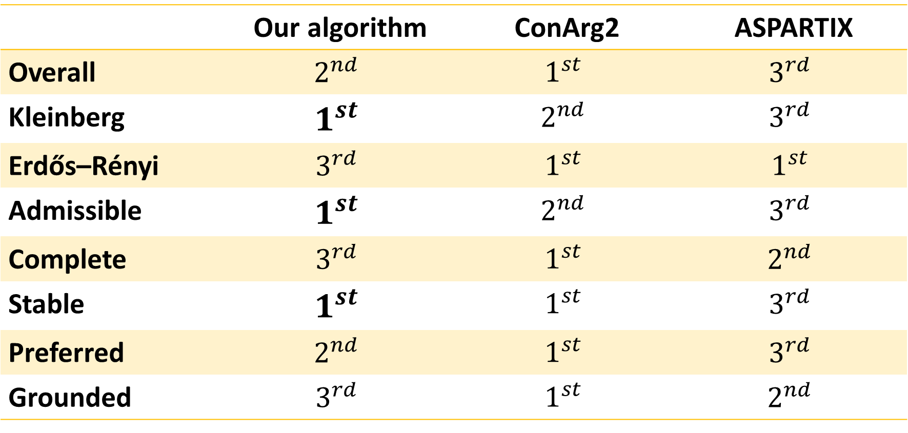

Benchmarking results
 | Our device | Their device
Processor | Intel i7-11850H, 2.50 GHz | Intel i7-970, 3.20 GHz
RAM | 16 GB | 16 GB
ASPARTIX – ICCMA 2015, 2019, 2021
ConArg2 – ICCMA 2015, 2017, 2021
Source: https://conarg.dmi.unipg.it
 | Our algorithm | ConArg2 | ASPARTIX
Overall | $$2^{nd}$$ | $$1^{st}$$ | $$3^{rd}$$
Kleinberg | $$1^{st}$$ | $$2^{nd}$$ | $$3^{rd}$$
Erdős–Rényi | $$3^{rd}$$ | $$1^{st}$$ | $$1^{st}$$
Admissible | $$1^{st}$$ | $$2^{nd}$$ | $$3^{rd}$$
Complete | $$3^{rd}$$ | $$1^{st}$$ | $$2^{nd}$$
Stable | $$1^{st}$$ | $$1^{st}$$ | $$3^{rd}$$
Preferred | $$2^{nd}$$ | $$1^{st}$$ | $$3^{rd}$$
Grounded | $$3^{rd}$$ | $$1^{st}$$ | $$2^{nd}$$
Notes:
I have said at the beginning of the presentation when I talked about the objectives of this dissertation paper that we proposed to implement a performant algorithm which solves the properties of an Argumentation Framework. I compared our algorithm with other 2 algorithms: ASPARTIX and ConArg2. Both of these applications participated at the International Competition on Computational Models of Argumentation, the biggest competition related to argumentation in 2015, 2017, 2019 and 2021. The tests has been executed on 2 types of graphs: Kleinberg and Erdos-Renyi. The results are exposed in this table and the conclusions in on the next slide.

Slide 18
Demo

Slide 19
Future work
Extend the algorithm to solve two more properties of an Argumentation Framework:
1
Semi-stable extensions;
Ideal extensions;
Integrate the algorithm in a Stable Marriage problem solver as described by Dung ;
2
Extend application and use Google OR-Tools to increase the performance of the algorithm
3
Notes:
As a future work, we have three objectives which we want to achieve. To extend the algorithm to solve other 2 properties of an Argumentation Framework: semi-stable extensions and ideal extensions, to integrate our algorithm in a Stable Marriage problem solver as it has been described by Dung and to improve the algorithm performance by using Google OR-Tools as a constraint solver library.

Slide 20
Conclusions
We have approached the problem of Argumentation Framework as a Constraint Satisfaction Problem (CSP);
We have implemented an algorithm in Java using Choco-Solver constraint library;
We have transformed Argumentation Framework properties into Choco-Solver constraints;
We have integrated the algorithm in a web application;
Notes:
In conclusion, in this dissertation paper we approached the Argumentation Framework problem as a Constraint Satisfaction Problem, out target was to implement an algorithm in Java based on constraint programming, transform the properties into propositional logic and then into Choco-Solver constraints and then to integrate the algorithm in a web application.

Slide 21
Thank you!

